Slide 1

Face Recognition project
Using Computer Vision

Slide 2
Project Steps
Part1.Data Cleaning & Data Collection | Part2.Training Model | Part3.Demo in real-world state
Kaggle Data sets | Label Encoder | Face detection
MTCNN | Scikit learn | Haarcascade frontalface
Face Net | Support Vector Machine | Test real world image
Tensor flow | Supervised learning
Save embedded np arrays | Save the model

Slide 3
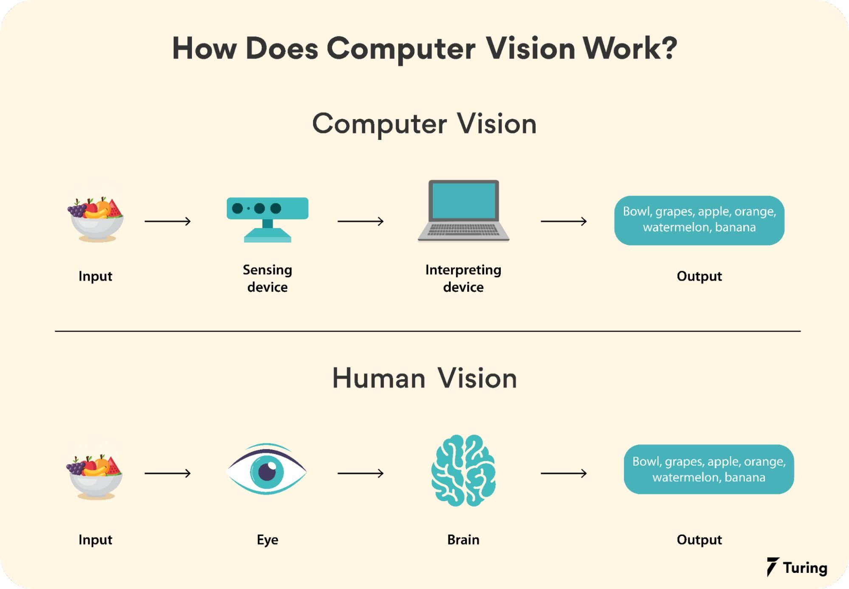

Slide 4
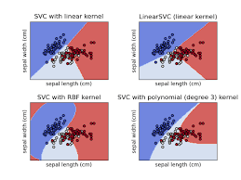
Face Recognition using Machine learning, deep learning algorithms.
Machine Learning Algorithms
(Train data)
Deep learning Algorithms
(Data Cleaning & Data collection)
SVM(Support Vector Machine)
MTCNN(Multi-task Cascaded Convolutional Neural Networks )
Face NET(developed by Google in 2015 for face recognition )

Slide 5
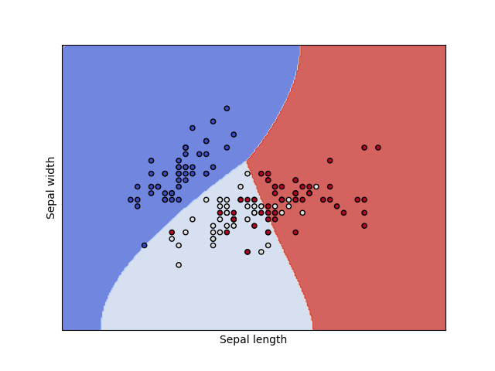

Slide 6
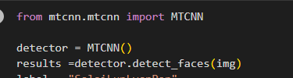
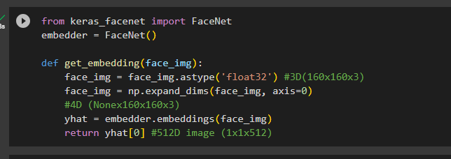
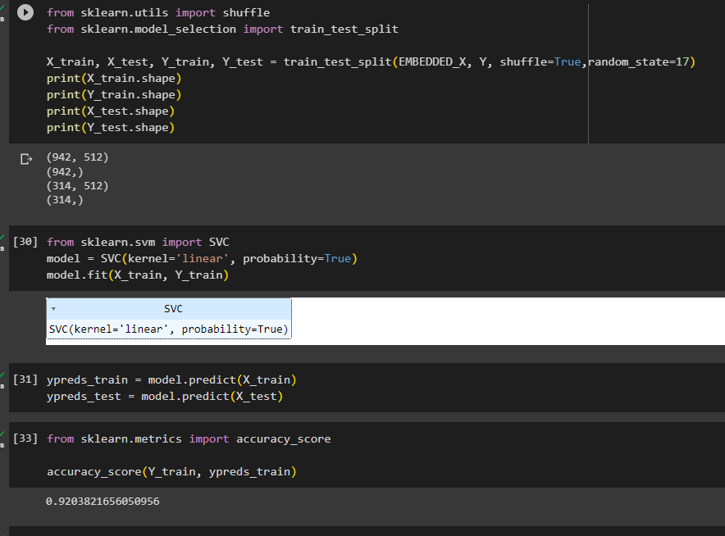
#MTCNN
MTCNN or Multi-Task Cascaded Convolutional Neural Networks is a neural network which detects faces and facial landmarks on images. It is the best for data cleaning.
# Face NET
    Face Net is a start-of-art face recognition, verification and clustering neural network. The loss function
    used at the last layer is called triplet loss. I used it for data embedding.
#SVM
  A support vector machine (SVM) is a supervised machine learning algorithm that can be used for classification and regression tasks. It is a discriminative model, meaning that it tries to find a decision boundary that best separates the two classes of data. I used it for data training.

Slide 7

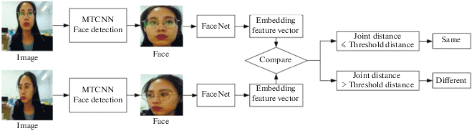
Project work flow
Image

Slide 8
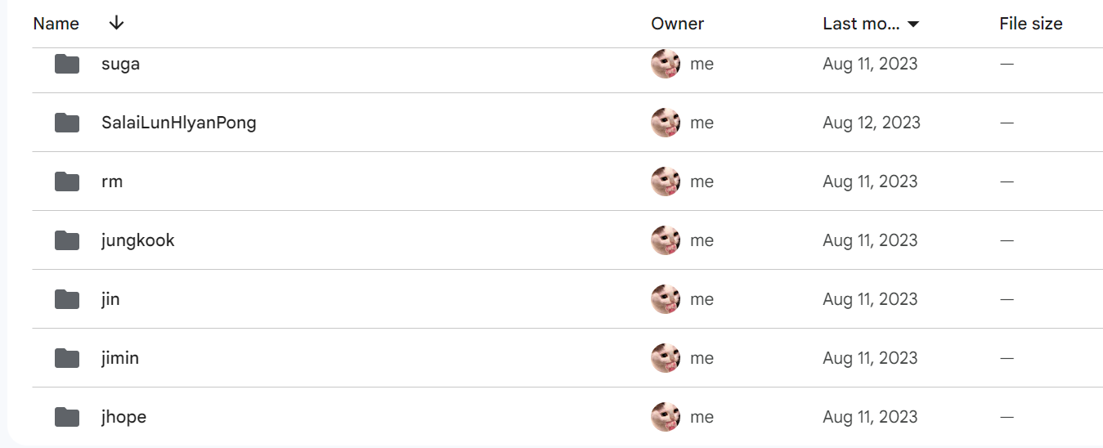
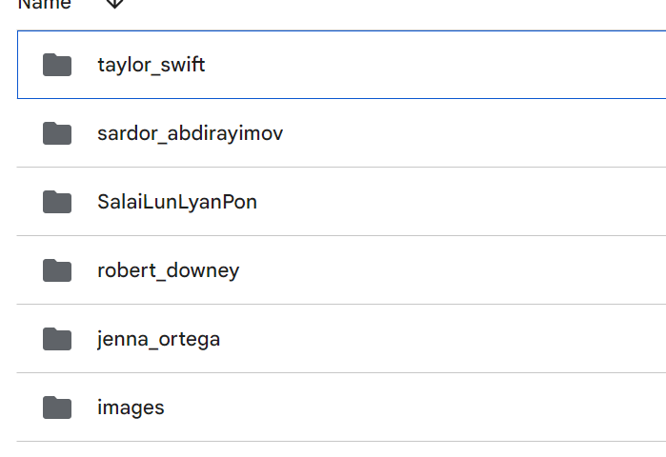
AI Ethics
These data are downloaded from Kaggle data sets.
We don’t use these data for any other violent purpose.
We will keep the recognition model after this project.

Slide 9
